Slide 1

d
d
c
c
a
a
c
a
a
a
b
a
a
a
b
b
bc
c
a
d
a
a
a
d
a
c
a
a
a
a
a
a
a
Respiration in µM CO₂/s * cm² of Abies alba (Blue) and Fagus sylvatica (Orange) in
three degradation classes (1, 2 and 4). On july (up) and October (down) Supperscripted letters denote statistically
significant differences at p < 0.05 after Wilcoxon signed-rank test.

Slide 2
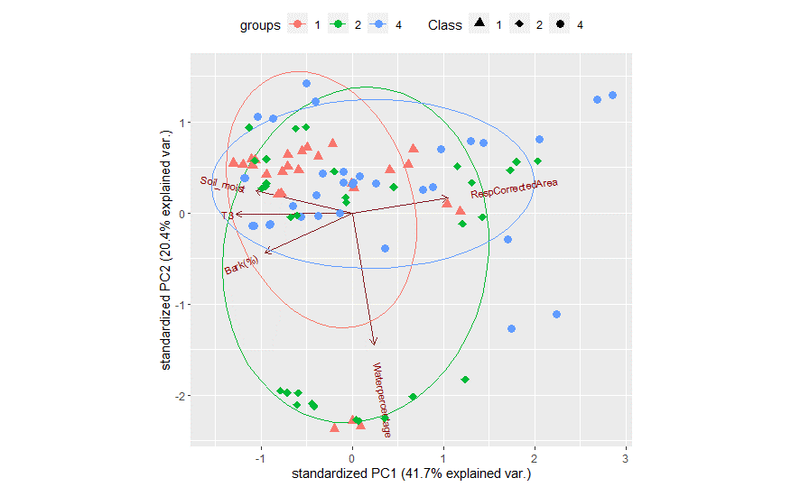
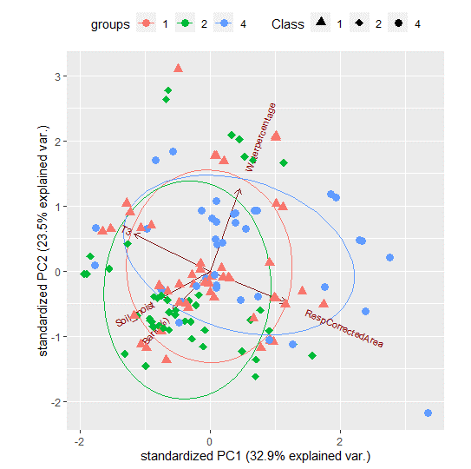
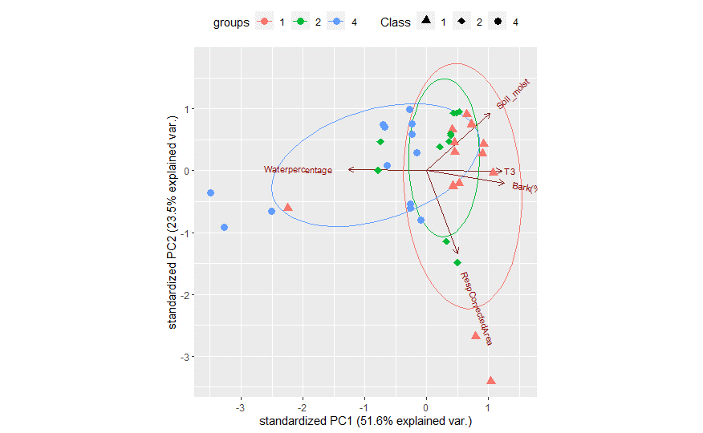
Abies alba
1 cm
10 cm
25 cm
Principal Componen análisis of Abies Alba comparing waterpercentage, Temperature (T3),Bark and Soil_moisture of the three diameters studied (1,10,25). Colours of the dots and ellipses correspond to samples of the three different degradation classes (1,2,4).

Slide 3
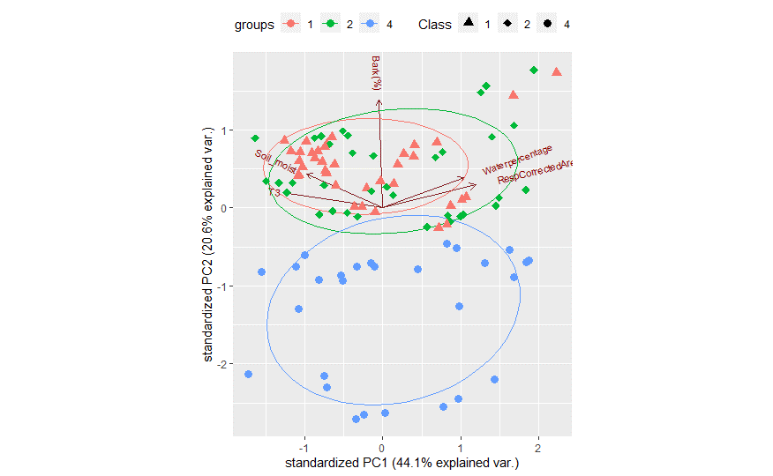
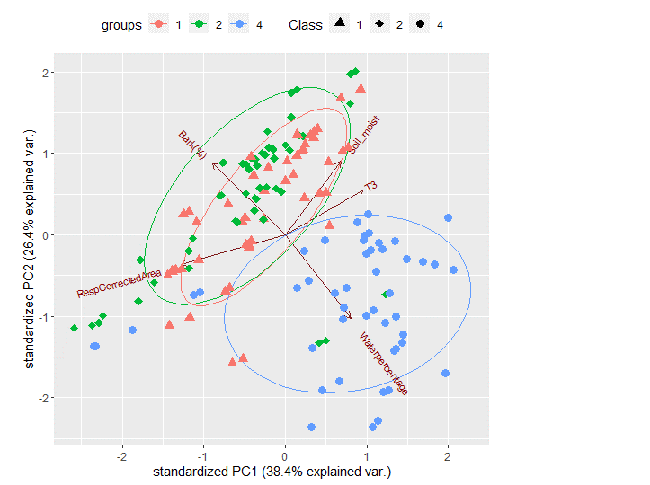
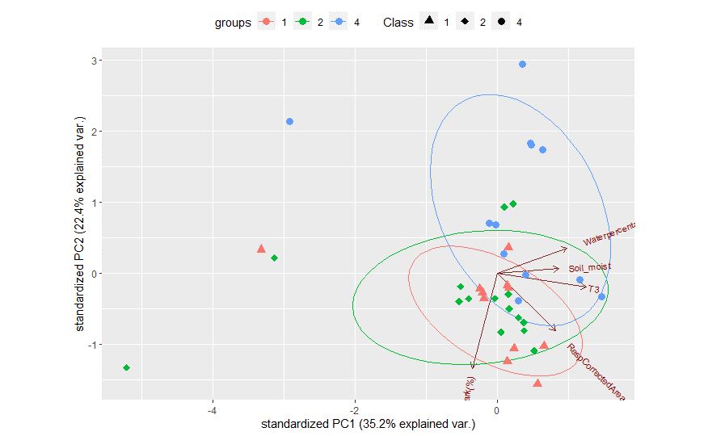
Fagus sylvatica
1 cm
10 cm
25 cm
Principal Componen análisis of Fagus sylvatica comparing waterpercentage, Temperature (T3),Bark and Soil_moisture of the three diameters studied (1,10,25). Colours of the dots and ellipses correspond to samples of the three different degradation classes (1,2,4).

Slide 4
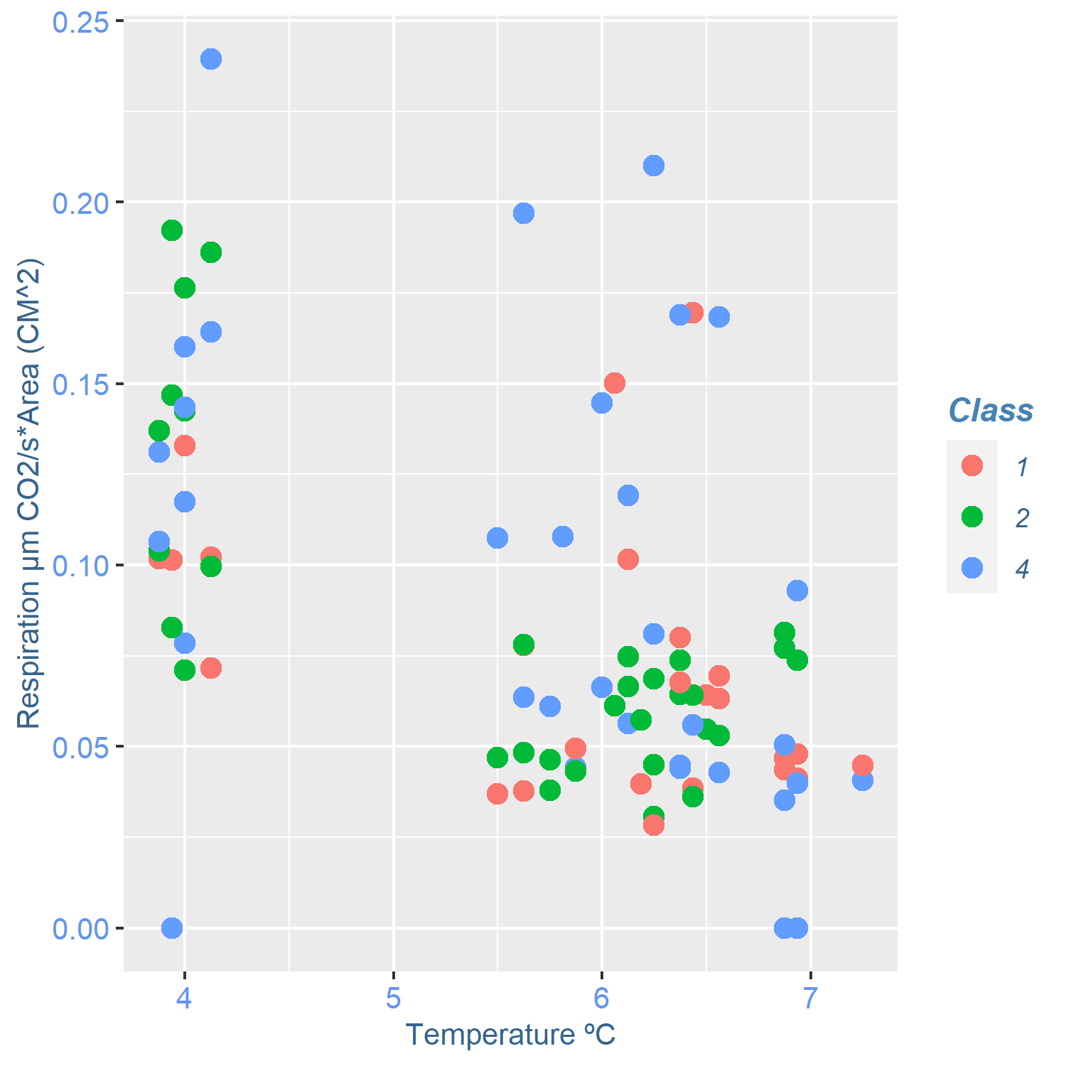
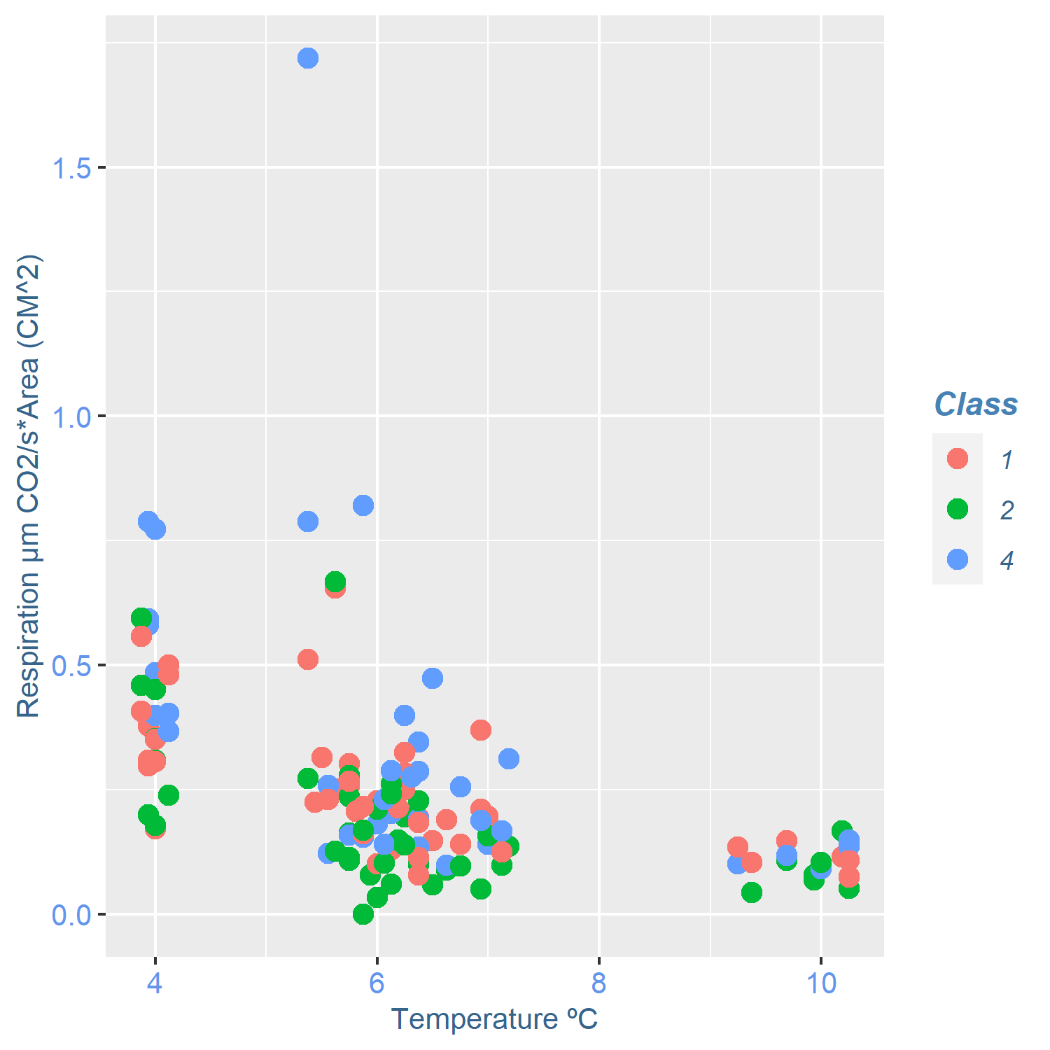
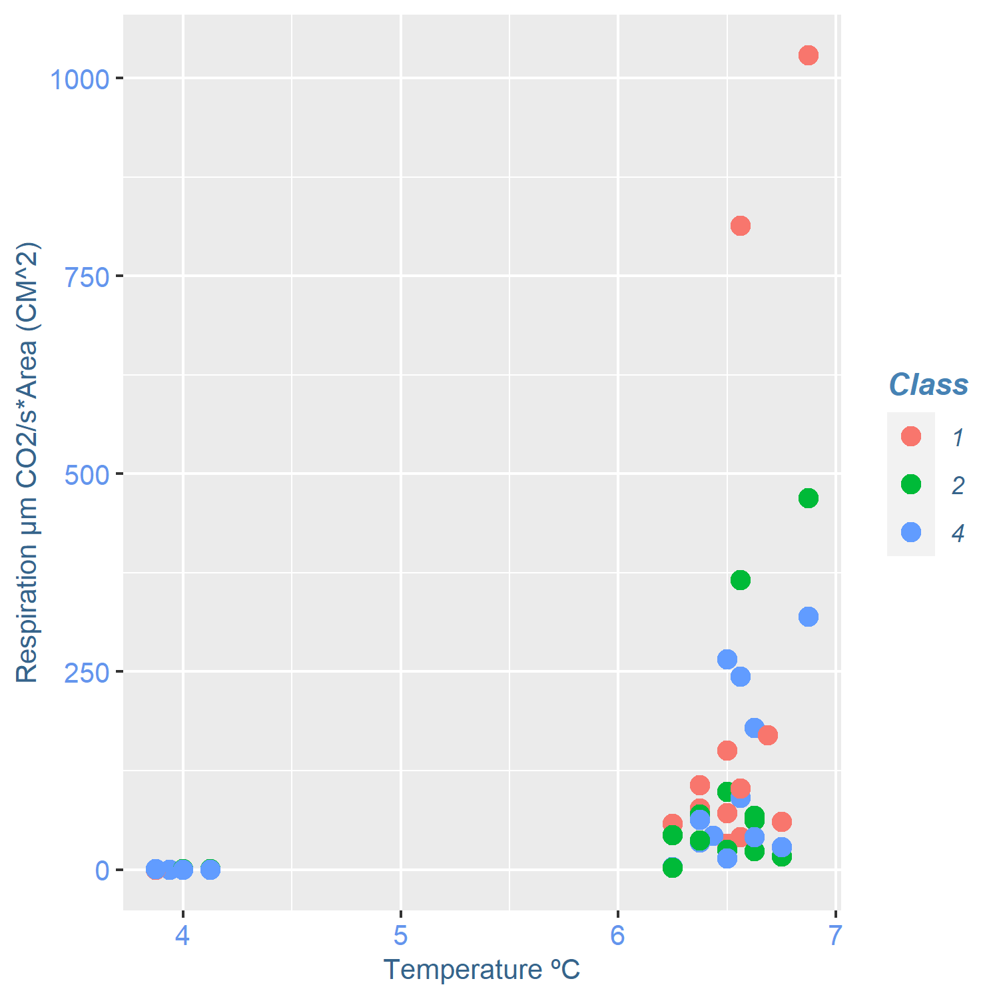
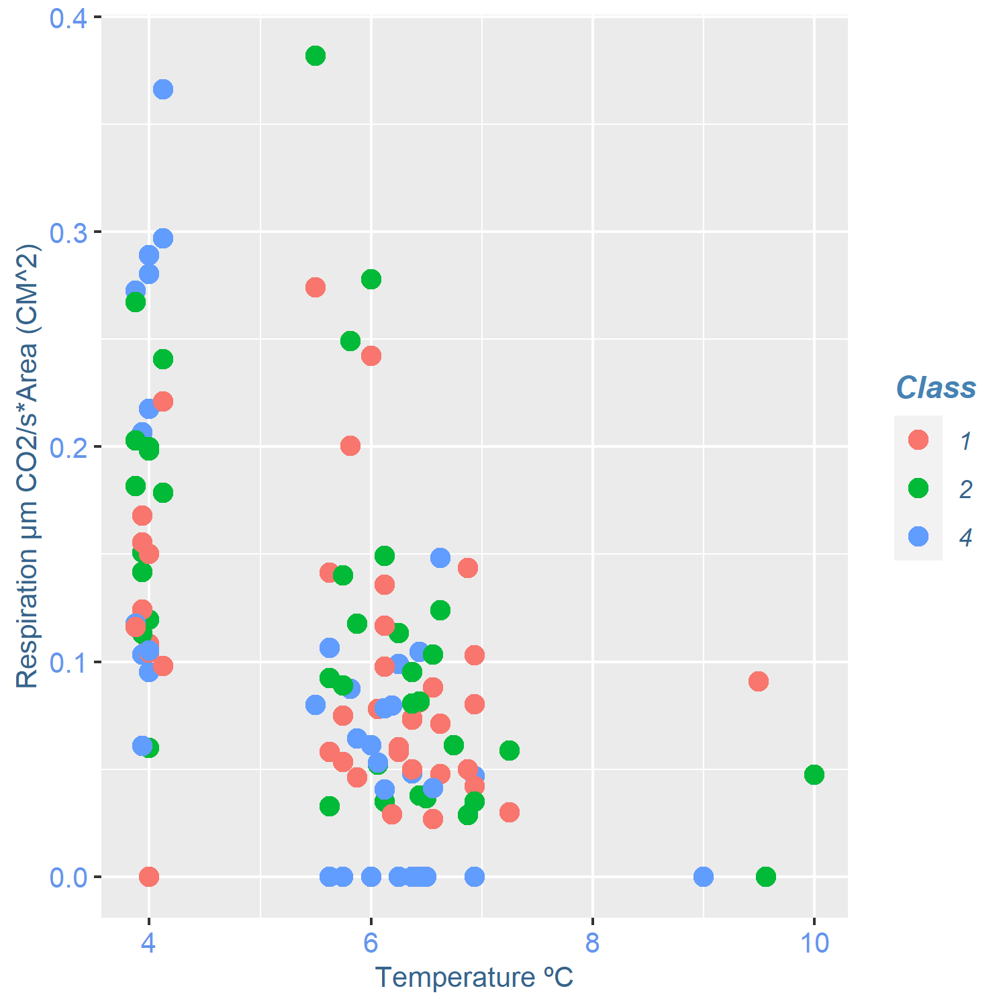
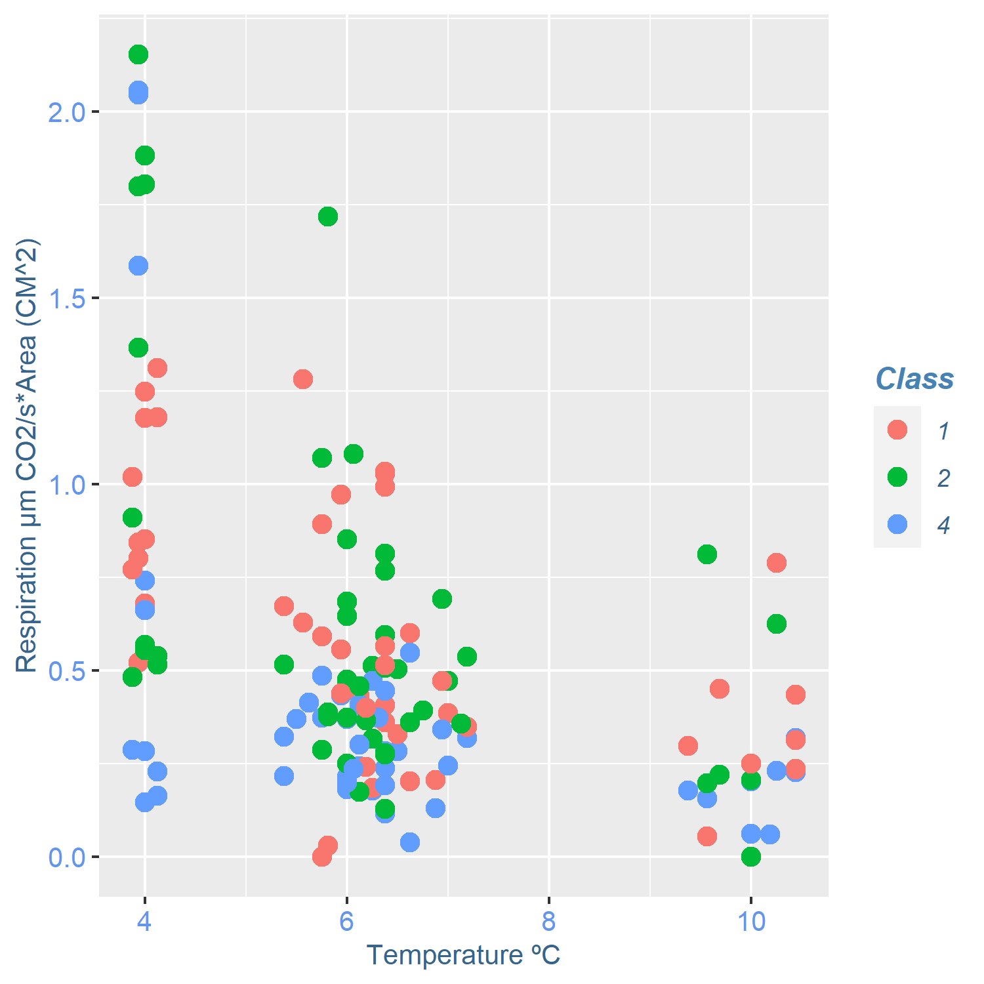
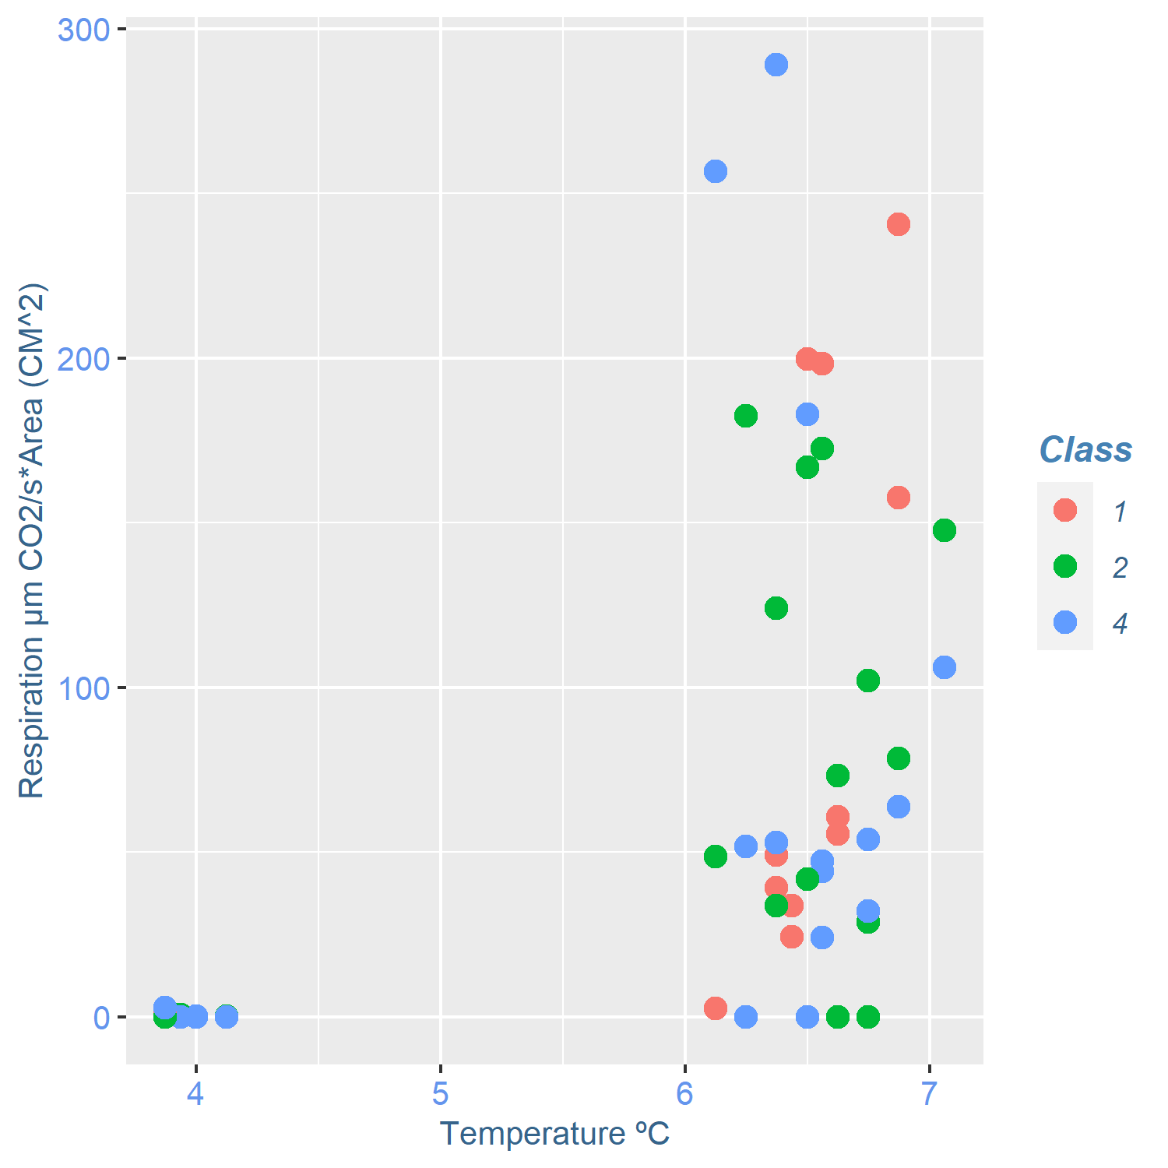
1 cm
10 cm
25 cm
Abies alba
Scatterplot of the respiration in µM CO₂/s * cm² (Y-axis) and Temperature (ºC) (X-axis) of Abies alba (up) and Fagus sylvatica (down). Colour of the dots correspond to degradation classes 1(red), 2(green) and 4(blue)
Fagus sylvatica

Slide 5
 | Abies Alba
 | 1cm | 10cm | 25cm
Class
1 | 0.7855 | 1.336*10^-7 Rho = -0.6655 | 0.0001 Rho=0.65072
2 | 0.01626* rho= -0.377 | 0.004688 rho = -0.389832 | 0.0006411 Rho=0.57
4 | 0.04126 rho = -0.324 | 1.19*10^-5* rho=-0.620062 | 1.344*10^-5 Rho=0.705
 | Fagus sylvatica
Class | 1cm | 10cm | 25cm
1 | 0.00162 Rho = -0.4715 | 1.394 * 10^-5 Rho = -0.577 | 3.417*10^-7 Rho=0.78
2 | 9.321*10^-6 Rho = -0.65 | 0.0003492 Rho= -0.485 | 0.2062
4 | 3.39 * 10^-5 Rho = -0.626 | 0.001999 Rho=-0.4308 | 0.03246 Rho=0.367

Slide 6
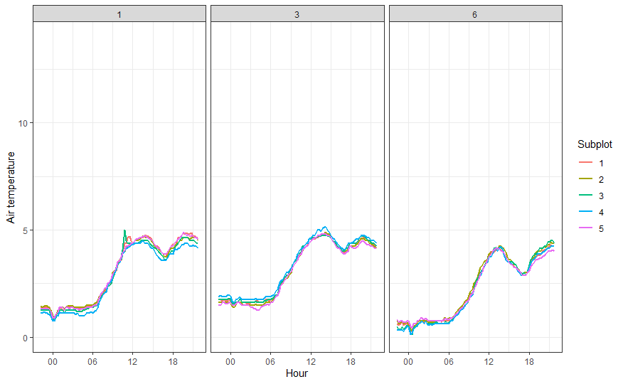
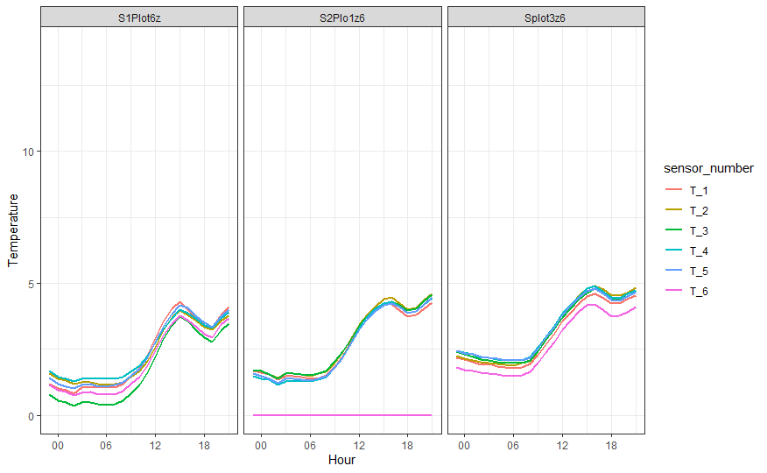
Temperatures
26/10/2021
Air T. (ºC)
T. Inside the wood (ºC)

Slide 7
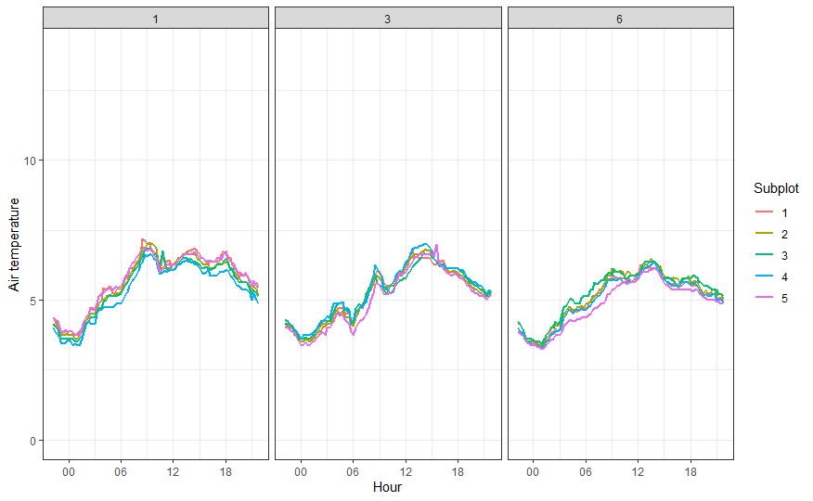
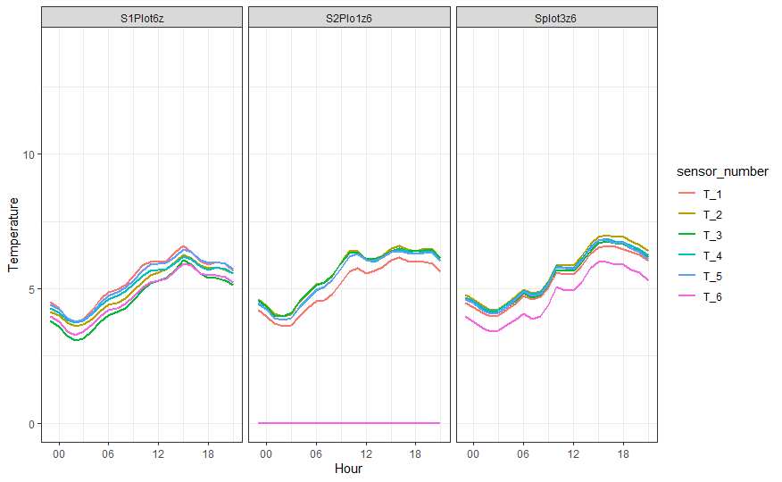
27/10/2021
Air T. (ºC)
T. Inside the wood (ºC)

Slide 8
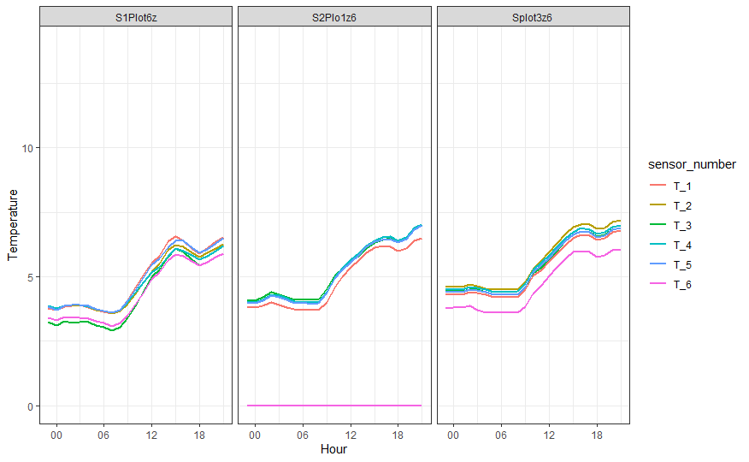
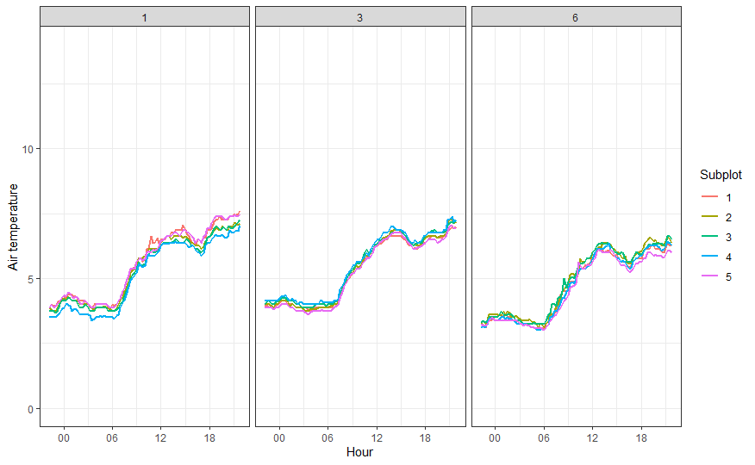
28/10/2021
Air T. (ºC)
T. Inside the wood (ºC)

Slide 9
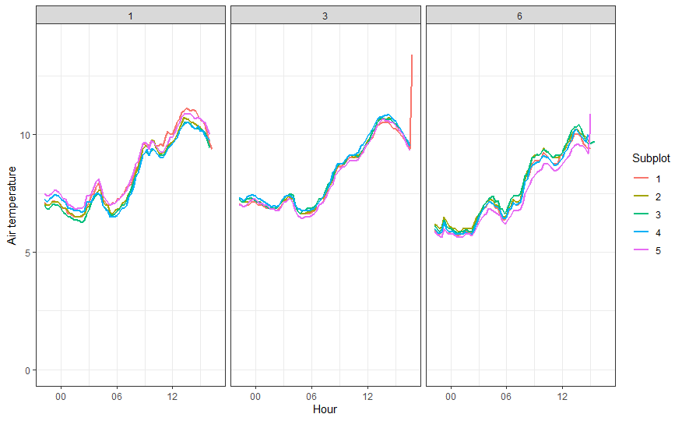
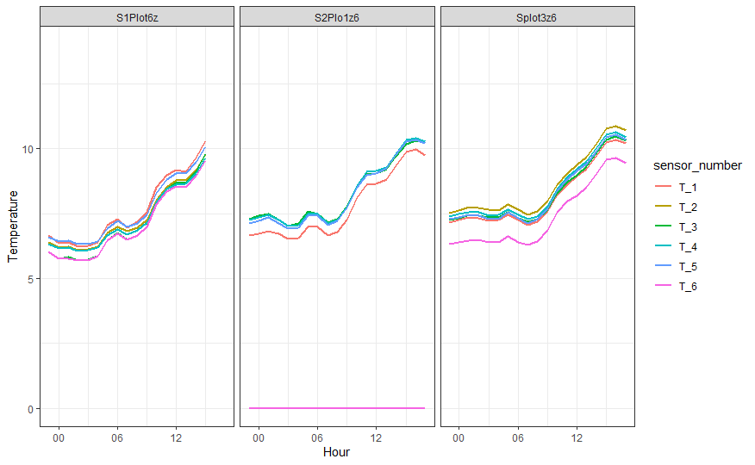
29/10/2021
Air T. (ºC)
T. Inside the wood (ºC)

Slide 10
July + October

Slide 11
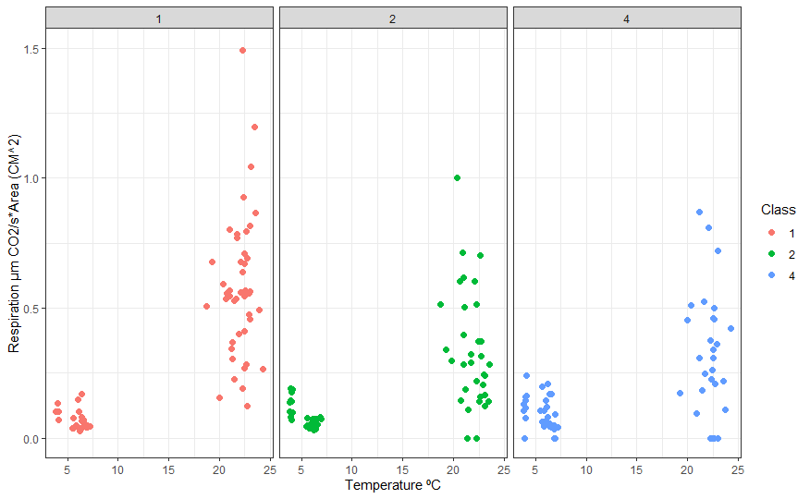
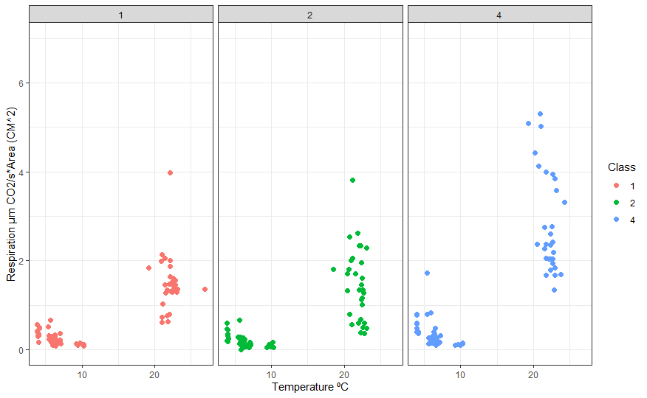
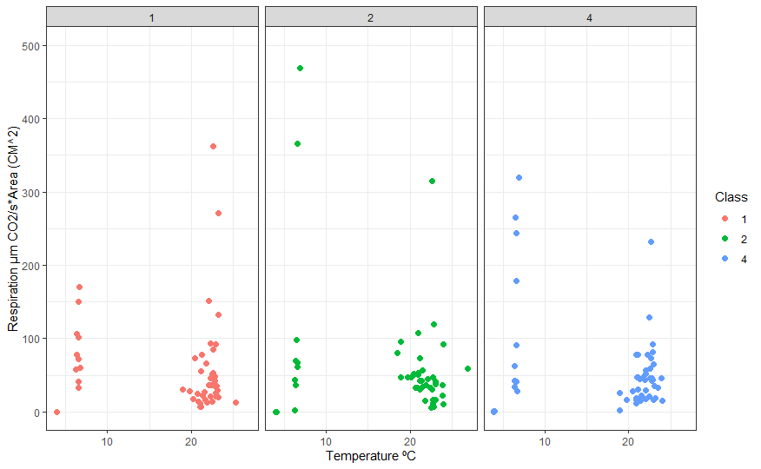
1cm
Abies alba
10cm
25cm

Slide 12
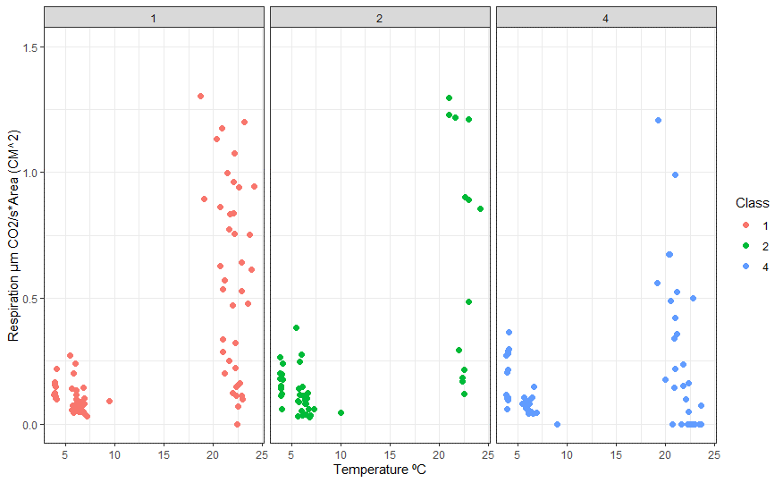
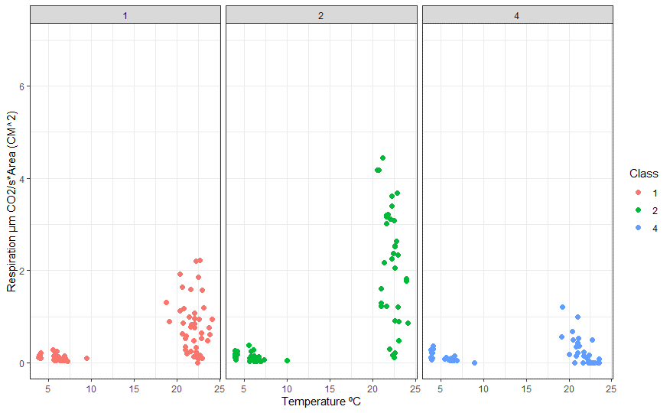
1cm
Fagus sylvatica
10cm
25cm

